Slide 1

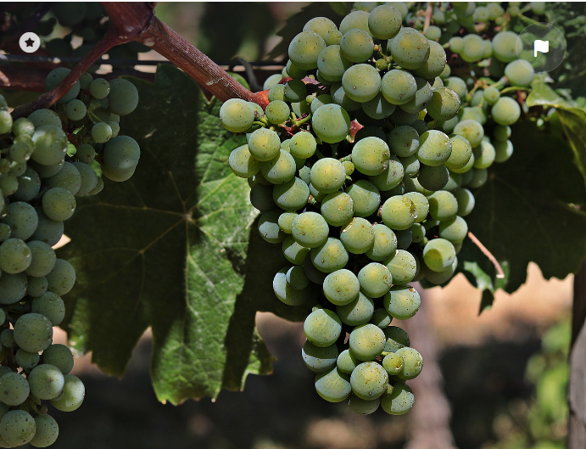
Wine Quality Prediction Using Logistic Regression
Python Expert
Class
An Analysis of Physicochemical Properties
Date: July, 2024
Presented by: Dr Nguzo Uche

Slide 2
INTRODUCTION
Objective: The objective of this project was to build a predictive model to classify the quality of wine based on physicochemical properties. The dataset provided included various features derived from physicochemical tests and a quality score. Given the challenges of a smaller dataset and potential imbalance, a Logistic Regression model was trained and evaluated.
Challenges: Smaller dataset and potential imbalance.
Solution: Train and evaluate a Logistic Regression model.

Slide 3
DATASET OVERVIEW
The dataset consists of the following features:
Fixed Acidity, Volatile Acidity, Citric Acid
Chlorides, Free Sulfur Dioxide, Total Sulfur Dioxide
pH, Type (White/Red), Citric Acid
Residual Sugar, Density, Sulphate and Alcohol
Target Variable: Wine Quality (binarized)
Quality > 5: Good quality (1)
Quality <= 5: Poor quality (0)

Slide 4
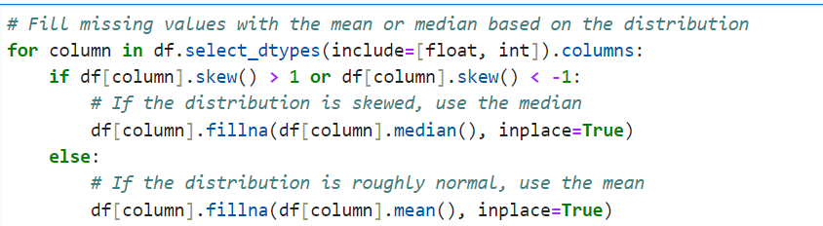
DATA PREPROCESSING
Missing Values: Filled with median values for numeric columns.
Categorical Variables: 'Type' column converted to numeric using one-hot encoding.
Feature Selection: The target variable quality was excluded from the features, and the selected features for the model were:
Selected features for the model: (X = Features)
Fixed Acidity,
Chlorides,
Free Sulfur Dioxide,
Total Sulfur Dioxide, pH, Type (White/Red), Density and Alcohol
Target variable is Quality. (y = Target)

Slide 5
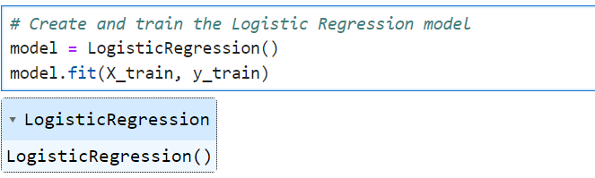


Model Training and Evaluation
Data Split: 80-20 ratio for training and testing sets.
Random_state=42: Ensures that anyone running the code will get the same result, which is important for reproducibility in research and development.
Model: Logistic Regression.
Evaluation Metrics:
Baseline Accuracy: 0.63
Accuracy Score: 0.65

Slide 6
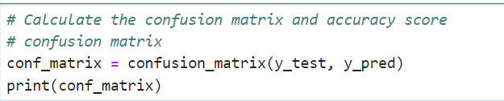
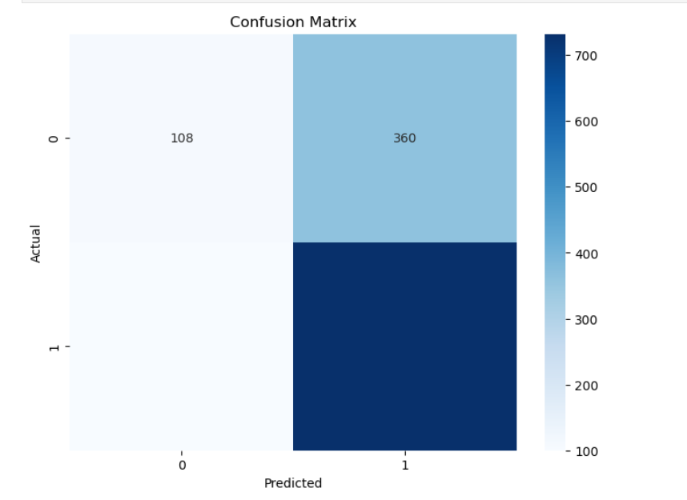
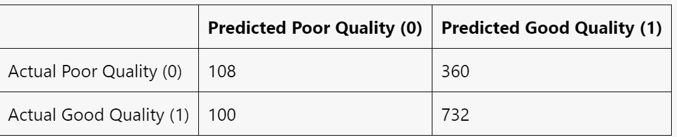
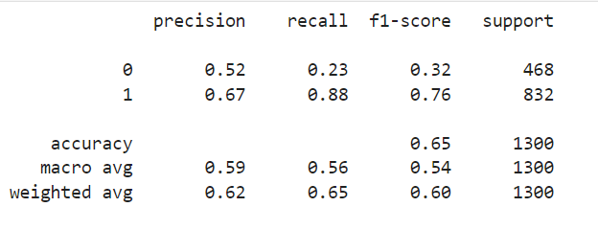
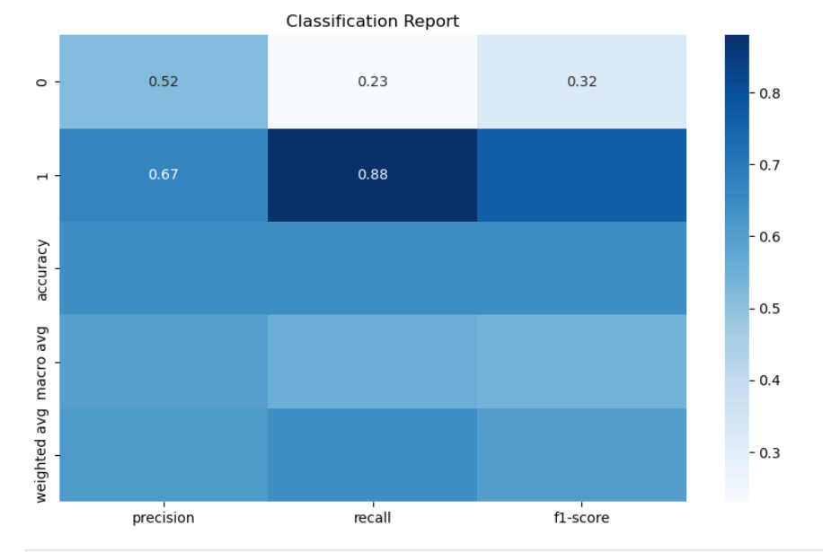

MODEL PERFORMANCE
Confusion Matrix
Classification Report:

Slide 7
ANALYSIS
Model accuracy of 0.65 is an improvement over the baseline accuracy of 0.63.
The model correctly predicted 732 good quality wines and 108 poor quality wines.
Misclassification:
360 good quality wines as poor quality.
100 poor quality wines as good quality.
Model performs better at predicting good quality wines than poor quality wines.
F1-Score: Important for evaluating model performance with imbalanced classes.
Indicates how well the model balances precision and recall.

Slide 8
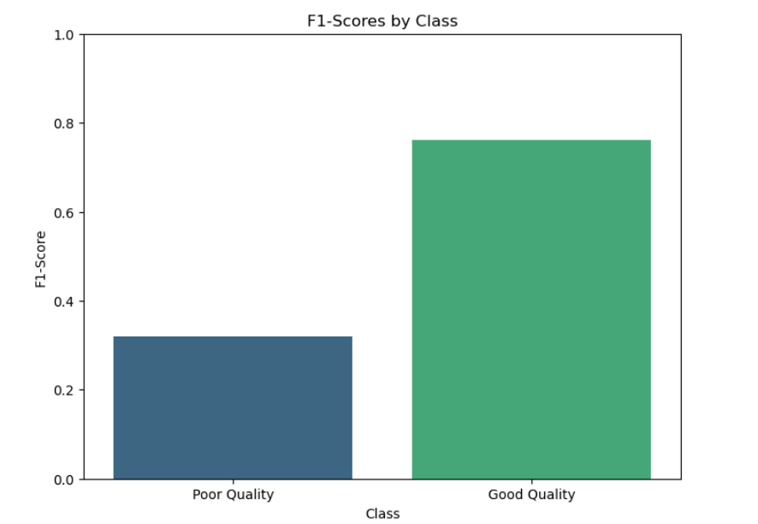
ANALYSIS
Understanding the F1-Score
Precision: The ratio of correctly predicted positive observations to the total predicted positives.
Precision = TP / (TP + FP).
Recall: The ratio of correctly predicted positive observations to the all observations in actual class.
Recall = TP / (TP + FN).
F1-Score: The weighted average of Precision and Recall. F1 Score = 2 * (Precision * Recall) /(Precision + Recall). It is best used when you want to seek a balance between Precision and Recall.

Slide 9
RECOMMENDATIONS FOR IMPROVEMENT
Data Balancing: Address the class imbalance using techniques such as SMOTE (Synthetic Minority Over-sampling Technique) or undersampling the majority class.
Feature Engineering: Investigate additional features or transformations that might help improve model performance.
Model Tuning: Experiment with different algorithms and hyperparameters to improve the predictive performance.
Cross-Validation: Ensure robust performance by validating the model on different subsets of the data.

Slide 10
FUTURE WORK
Future work may involve validating the model on a different dataset to ensure generalizability
Need to explore more complex models or feature engineering to further enhance predictive performance.
Applying additional techniques to handle class imbalance.
These efforts aim to develop a more robust and reliable wine quality prediction model that can provide valuable insights for wine producers and consumers.
Data Sources
https://www.kaggle.com/datasets/khushirakheja/wine-quality-prediction-using-logistic-regression/data

Slide 11
CONCLUSION
The model performs reasonably well for predicting good quality wines but has significant room for improvement in predicting poor quality wines. This is reflected in the higher F1-score for good quality wines and the lower F1-score for poor quality wines.
The overall F1-scores (macro and weighted averages) indicate a moderate balance, with the model leaning towards better performance for the majority class (good quality).

Slide 12
THANKS

